Slide 1

B.Tech Cyber Security · AI Project
AI/ML-Based Brute-Force Attack Detection System
ADITYA LOHAN · 02 · COER UNIVERSITY
Notes:
Introduce the title and project scope. This presentation outlines an intelligent machine-learning approach to identifying brute-force credential attacks on authentication endpoints.

Slide 2
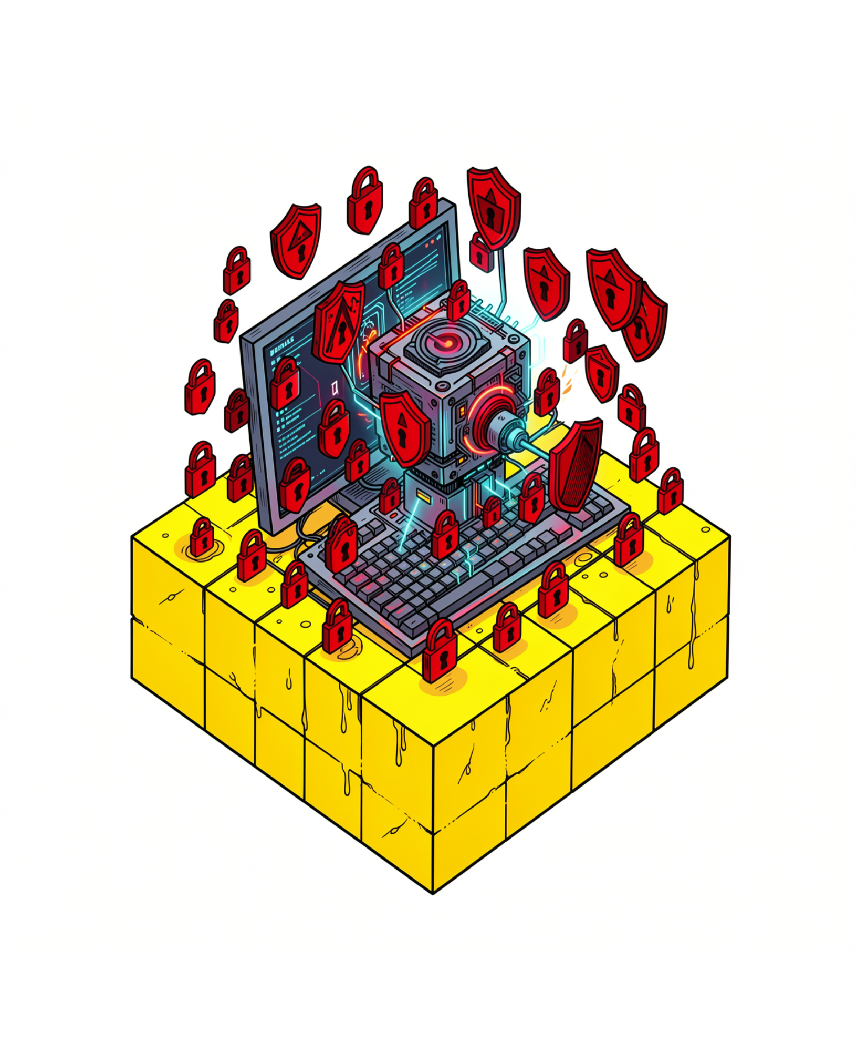
THREAT LANDSCAPE
Why brute-force detection matters
A brute-force attack systematically attempts many password combinations until one succeeds, threatening critical systems, networks, and confidential data.
Repeated failure signatures
Rapid succession of authentication rejections is often the primary signal of automated exploitation.
Continuous AI/ML monitoring
Machine learning monitors traffic profiles dynamically to spot subtle velocity patterns without human lag.
Notes:
Explain brute-force attacks in plain terms: automated credential stuffing and password guessing. Highlight why manual reaction is too slow when scripts execute hundreds of guesses per minute.

Slide 3
OPERATIONAL BOTTLENECKS
Manual monitoring cannot keep up
Modern organizations generate massive volumes of authentication events that overwhelm security teams relying on manual audits or rigid rules.
High Volume
Rapid Speed
Rigid Rules
Audit log overload
Automated tools
Static thresholds fail
Security teams cannot manually inspect thousands of distributed login logs generated every second across multiple web services.
Adversaries use credential stuffing scripts that execute bursts of dozens of attempts per second, breaching accounts before analysts notice.
Simple static rules (e.g., lock after 5 fails) miss slow-and-low distributed attacks and flood administrators with false alarms.
Conclusion: An automated, intelligent machine-learning detector is required to evaluate behavioral patterns in real time.
Notes:
Walk through the three main barriers: overwhelming log scale, script execution speed, and the brittleness of static rules. Emphasize why intelligence must replace manual scrutiny.

Slide 4





PROJECT GOALS
What the system should achieve
The proposed architecture focuses on automated behavioral classification and accessible alert generation.
Detect behavior
Isolate attacks
Classify with ML
Cut manual work
Actionable alerts
Identify unusual anomalies and abnormal login frequencies instantly.
Pinpoint targeted brute-force spikes against user accounts.
Apply lightweight classification algorithms for real-time decisions.
Minimize tedious human log reviews and false alert fatigue.
Display plain, understandable security alerts for fast incident response.
Notes:
Describe each objective briefly. Stress that the goal is not only detecting the attack with machine learning, but also communicating clearly to operators with actionable warnings.

Slide 5
END-TO-END PIPELINE
From login activity to security alert
A six-stage machine learning workflow converts raw authentication packets into immediate threat intelligence.
01
02
03
04
05
06
Collect Logs
Clean Data
Extract Features
Run ML Model
Predict State
Trigger Alert
Ingest authentication packets and server access requests.
Normalize timestamps, resolve missing values, and structure events.
Pass behavioral vectors through the trained classifier.
Assign probabilistic labels: Normal vs. Suspicious activity.
Dispatch automated notices and incident flags to operators.
Compute login velocity, error frequencies, and origin reputation.
Linear pipeline ensures low processing latency for enterprise boundary gateways.
Notes:
Walk from left to right: raw data ingestion, feature preprocessing, model scoring, and alert generation. Emphasize how each stage prepares structured input for the next.

Slide 6
INPUT VARIABLES & DATASET
Features reveal login behavior
Machine learning algorithms differentiate normal user errors from automated attacks using targeted temporal and statistical indicators.
Failed & successful attempt counts
Attempts per minute (Velocity)
DATA FOUNDATION
Authentication request rate indicating automated credential stuffing tools.
Dataset Source
Ratio of failed attempts relative to successful sessions across rolling time windows.
Experiments are conducted using public benchmark network datasets (such as UNSW-NB15 / KDD-CUP99 derivatives) or simulated educational lab authentication environments.
Unique usernames per IP
Time delta between requests
Origin analysis: Flags unknown IP addresses vs. trusted enterprise subnets.
Detects password-spraying attacks that target multiple accounts from one source.
Sub-second inter-arrival intervals typical of machine-driven attack scripts.
Notes:
Explain how features capture user behavior versus robot behavior. Highlight attempts-per-minute and time-delta as high-leverage indicators of script activity.

Slide 7
MODEL EVALUATION
Comparing simple classification models
A standard training and testing split helps evaluate three foundational machine learning algorithms on detection accuracy and interpretability.
01
02
03
04
1. Preprocess & Label
2. Split Dataset
3. Train Models
4. Compare & Choose
Scale numerical metrics and encode binary labels.
Partition into training (70-80%) and testing (20-30%) subsets.
Fit Logistic Regression, Decision Tree, and Random Forest.
Benchmark confusion matrices and select optimal model.
Logistic Regression
Decision Tree
Random Forest
Linear baseline model. Fast computation, highly interpretable, best for linearly separable velocity thresholds.
Hierarchical if-else rule structure. Easy to visualize security boundaries and audit reasoning paths.
Ensemble of decision trees. Robust against noise and overfitting, making it ideal for real-world deployments.
Notes:
Compare the three classifiers: Logistic Regression as a fast linear baseline, Decision Tree for explainable logic, and Random Forest for ensemble accuracy and noise reduction.

Slide 8
DETECTION LOGIC
The model turns patterns into decisions
Classifiers evaluate multidimensional login velocity to distinguish human mistakes from malicious attacks.
STATUS: BENIGN
STATUS: THREAT DETECTED
Normal Activity Pattern
Suspicious Attack Pattern
Typing mistakes, occasional forgotten passwords, and natural human intervals between re-attempts.
Automated wordlists and dictionary testing cycling through credentials rapidly.
Few varied login attempts (1–3 tries)
Extended time between inputs (> 5 seconds)
Known corporate or residential IP addresses
Many fast failures across multiple accounts
Sub-second intervals between attempts
Unknown or anomalous foreign IP ranges
✓ Classification: Normal Login
⚠ Potential Brute-Force Attack
Concrete evaluation rule: 45 failed login attempts in 60 seconds from an unknown IP address triggers an immediate critical security alert.
Notes:
Contrast normal user behavior with automated brute-force attacks. Emphasize that context matters: 45 failures in one minute is unmistakably non-human.

Slide 9
ROADMAP & IMPACT
Useful today, stronger tomorrow
The system offers immediate operational value while serving as a modular foundation for advanced enterprise defense.
Current
Future
Key Advantages
Future Scope
Automated detection: Replaces tedious manual inspection of authentication records.
Faster identification: Recognizes suspicious velocity spikes within seconds.
Reduced fatigue: Filters out routine errors to highlight true security incidents.
Accessible monitoring: Practical design suitable for campus networks and web servers.
Streaming real-time pipelines: Kafka or Redis message queues for instant packet scoring.
NIDS integration: Connect model outputs directly into Snort or Suricata firewalls.
SIEM connectivity: Export structured CEF/JSON alerts to Splunk or Wazuh.
Deep learning: LSTM recurrent networks to learn complex temporal sequences.
Notes:
Summarize immediate benefits on the left and future engineering extensions on the right. Mention enterprise integrations like SIEM and NIDS as logical progression paths.

Slide 10

SUMMARY & CONCLUSION
Machine learning makes monitoring smarter
Brute-force credential attacks remain a prevalent and dangerous entry vector in cyber security.
Machine learning analyzes behavioral patterns across frequency, timing, and source to reliably detect threats.
Automated pipelines eliminate manual monitoring blind spots and accelerate incident containment.
Intelligent classifiers establish a modern, scalable foundation for cyber-defense infrastructure.
Thank You
Notes:
Summarize the core takeaways: machine learning moves cyber defense from reactive manual checking to proactive, pattern-based threat intelligence. Open the floor for questions.

